Slide 1
Regular Expressions
(or what the hell am I doing with *?+.\(){}[] among other chars)
(w|h)at* [are w]e do+ing?
Matches:
wat re doooin
ha we doing
Doesn’t Match:
nope
what are we doing?

Slide 2
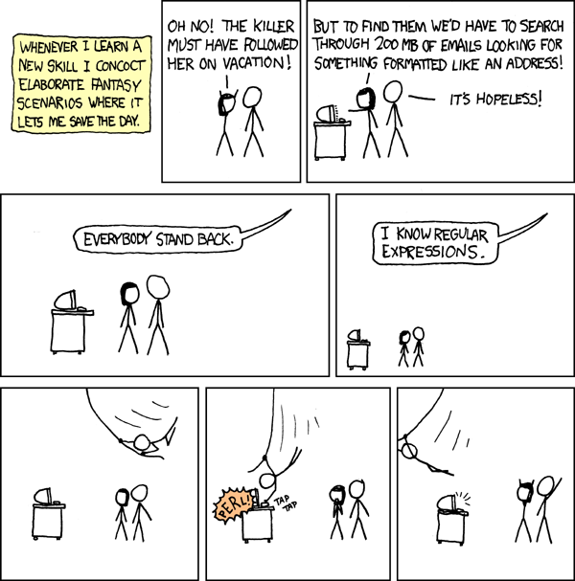
Regular Expressions can be AWESOME

Slide 3
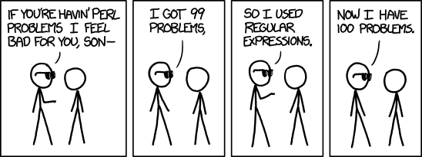
Regular Expressions can be HARD

Slide 4
What is a Regular Expression?
A regular expression (regex) describes a pattern to match multiple input strings.
Regular expressions descend from a fundamental concept in Computer Science called finite automata theory
Regular expressions are endemic to Unix
Some utilities/programs that use them:
  vi, ed, sed, and emacs editors (text or stream)
  awk, tcl, perl and Python scripting languages
  grep, egrep, fgrep matching utilities
  Compilers our favorite ☺
The simplest regular expression is a string of literal characters to match.
The string matches the regular expression if it contains the substring.

Slide 5
Regular Expressions: Exact Matches
regular expression
c k s
UNIX Tools rocks.
match
UNIX Tools sucks.
match
UNIX Tools is okay.
no match

Slide 6
Regular Expressions: Multiple Matches
A regular expression can match a string in more than one place.
regular expression
a p p l e
Scrapple from the apple.
match 1
match 2

Slide 7
Regular Expressions: Matching Any Character
The . regular expression can be used to match any character.
regular expression
o .
For me to poop on.
match 1
match 2

Slide 8
Regular Expressions: Alternate Character Classes
Character classes [] can be used to match any specific set of characters.
regular expression
b [eor] a t
beat a brat on a boat
match 1
match 2
match 3

Slide 9
Regular Expressions: Negated Character Classes
Character classes can be negated with the [^] syntax.
regular expression
b [^eo] a t
beat a brat on a boat
match
no match

Slide 10
Regular Expressions: Other Character Classes
Other examples of character classes:
  [aeiou] will match any of the characters a, e, i, o, or u
  [kK]orn will match korn or Korn
Ranges can also be specified in character classes
  [1-9] is the same as [123456789]
  [abcde] is equivalent to [a-e]
You can also combine multiple ranges
  [abcde123456789] is equivalent to [a-e1-9]
Note that the - character has a special meaning in a character class but only if it is used within a range
  [-123] would match the characters -, 1, 2, or 3

Slide 11
Regular Expressions: Named Character Classes
Commonly used character classes can be referred to by name
  alpha,
  lower,
  upper,
  alnum,
  digit,
  punct,
  cntl
Syntax [:name:]
  [a-zA-Z] [[:alpha:]]
  [a-zA-Z0-9] [[:alnum:]]
  [45a-z] [45[:lower:]]
Important for portability across languages

Slide 12
Regular Expressions: Anchors
Anchors are used to match at the beginning or end of a line (or both).
^ means beginning of the line
$ means end of the line
regular expression
^ b [eor] a t
beat a brat on a boat
match
regular expression
b [eor] a t $
beat a brat on a boat
match
^word$
^$

Slide 13
Regular Expression: Repetions
The * is used to define zero or more occurrences of the single regular expression preceding it.
regular expression
y a * y
I got mail, yaaaaaaaaaay!
match
regular expression
o a * o
For me to poop on.
match
.*

Slide 14
Regular Expressions: Repetion Ranges, Subexpressions
Ranges can also be specified
  {n,m} notation can specify a range of repetitions for the immediately preceding regex
  {n} means exactly n occurrences
  {n,} means at least n occurrences
  {n,m} means at least n occurrences but no more than m occurrences
Example:
  .{0,} same as .*
  a{2,} same as aaa*
If you want to group part of an expression so that * applies to more than just the previous character, use ( ) notation
Subexpresssions are treated like a single character
  a* matches 0 or more occurrences of a
  abc* matches ab, abc, abcc, abccc, …
  (abc)* matches abc, abcabc, abcabcabc, …
  (abc){2,3} matches abcabc or abcabcabc

Slide 15
Single Quoting Regex
Since many of the special characters used in regexs also have special meaning to the shell, it’s a good idea to get in the habit of single quoting your regexs
  This will protect any special characters from being operated on by the shell
  If you habitually do it, you won’t have to worry about when it is necessary
Even though we are single quoting our regexs so the shell won’t interpret the special characters, sometimes we still want to use an operator as itself
To do this, we escape the character with a \ (backslash)
Suppose we want to search for the character sequence ‘a*b*’
  Unless we do something special, this will match zero or more ‘a’s followed by zero or more ‘b’s, not what we want!
  ‘a\*b\*’ will fix this - now the asterisks are treated as regular characters

Slide 16
Extended Regular Expressions
Regex also provides an alternation character | for matching one or another subexpression
  (T|Fl)an will match Tan or Flan
  ^(From|Subject): will match the From and Subject lines of a typical email message
    It matches a beginning of line followed by either the characters From or Subject followed by a ‘:’
Subexpressions are used to limit the scope of the alternation
  At(ten|nine)tion then matches Attention or Atninetion, not Atten or ninetion as would happen without the parenthesis - Atten|ninetion

Slide 17
Extended Regular Expressions: Repetition Shorthands
The * (star) has already been seen to specify zero or more occurrences of the immediately preceding character
The + (plus) means one or more
  abc+d will match abcd, abccd, or abccccccd but will not match ‘abd’ while abc?d will match abd and abcd but not ‘abccd’
  Equivalent to {1,}
The ? (question mark) specifies an optional character, the single character that immediately precedes it
  July? will match Jul or July
  Equivalent to {0,1}
  Also equivalent to (Jul|July)
The *, ?, and + are known as quantifiers because they specify the quantity
Quantifiers can also be used with subexpressions
  (a*c)+ will match c, ac, aac or aacaacac but will not match ‘a’ or a blank line

Slide 18
Regular Expressions: Backreferences
Sometimes it is handy to be able to refer to a match that was made earlier in a regex
This is done using backreferences
  \k is the backreference specifier, where k is a number
For example, to find if the first word of a line is the same as the last:
  ^\([[:alpha:]]\{1,\}\).*\1$
  The \([[:alpha:]]\{1,\}\) matches 1 or more letters

Slide 19
Regular Expressions: Some Practical Examples
Variable names in C
  [a-zA-Z_][a-zA-Z_0-9]*
Dollar amount with optional cents
  \$[0-9]+(\.[0-9][0-9])?
Time of day
  (1[012]|[1-9]):[0-5][0-9] (am|pm)
HTML headers <h1> <H1> <h2> …
  <[hH][1-4]>

Slide 20
Regular Experessions: Quick Refrences
fgrep, grep, egrep
grep, egrep
grep
egrep
x xyz | Ordinary characters match themselves (NEWLINES and metacharacters excluded) Ordinary strings match themselves
\m ^ $ . [xy^$x] [^xy^$z] [a-z] r* r1r2 | Matches literal character m Start of line End of line Any single character Any of x, y, ^, $, or z Any one character other than x, y, ^, $, or z Any single character in given range zero or more occurrences of regex r Matches r1 followed by r2
\(r\) \n \{n,m\} | Tagged regular expression, matches r Set to what matched the nth tagged expression (n = 1-9) Repetition
r+ r? r1|r2 (r1|r2)r3 (r1|r2)* {n,m} | One or more occurrences of r Zero or one occurrences of r Either r1 or r2 Either r1r3 or r2r3 Zero or more occurrences of r1|r2, e.g., r1, r1r1, r2r1, r1r1r2r1,…) Repetition

Slide 21
Regex Metacharacters
\b Matches a word boundary, that is, the position between a word and a space.
For example, er\b matches the er in "never" but not the er in verb.
\B Matches a nonword boundary. ea*r\B matches the ear in never early.
\d Matches a digit character. Equivalent to [0-9].
\D Matches a nondigit character. Equivalent to [^0-9].
\f Matches a form-feed character.
\n Matches a newline character.
\r Matches a carriage return character.
\s Matches any white space including space, tab, form-feed, etc. Equivalent to [ \f\n\r\t\v].
\S Matches any nonwhite space character. Equivalent to [^ \f\n\r\t\v].
\t Matches a tab character.
\v Matches a vertical tab character.
\w Matches any word character including underscore. Equivalent to [A-Za-z0-9_].
\W Matches any nonword character. Equivalent to [^A-Za-z0-9_].

Slide 22
(w|h)at* [are w]e do+ing?
(w|h) – or
  Matches w or h
t*
  Matches zero or more t’s
[are w]
  Matches one of those characters
o+
  Matches one or more o’s
g?
  Optionally matches a single ‘g’
(w or h)a(zero or more t’s) (one of {a,r,e, ,w})e d(one or more o)in(optional g)
Minimally matching string: ha we doin

Slide 23
One awesome resource and
An Upcoming tutorial
http://regexone.com/
This is live matching / interactive
Interactive Terminal Demos with awk/sed/grep/find on Thursday!

